Slide 1

Deep Learning for Automatic Modulation Classification
Under Dr. Kamal Captain:
Group 34
Aditya Saggar (U17EC048)
Devang Amin (U17EC123)
Lavanya Pareek (U17EC093)

Slide 2

Presentation Timeline
Introduction to Modulation Classification
Motivation to use Deep Learning
Problem Statement & Objective
Neural Network
Results and Future Scope
Dataset Evaluation
Current Limitations

Slide 3
Modulation Recognition: Introduction
"Task of classifying the modulation type of a received radio signal as a step towards understanding what type of communications scheme and emitter is present"
Civilian Applications
Military Applications
Cognitive Radio: Dynamic Spectrum Access
Notes:
Here we would introduce modulation recognition like in the report We would first talk about why we use it:
1) Cognitive Radio
2) Signal Space is noisy environment – military and civilian applications
Refer to report

Slide 4
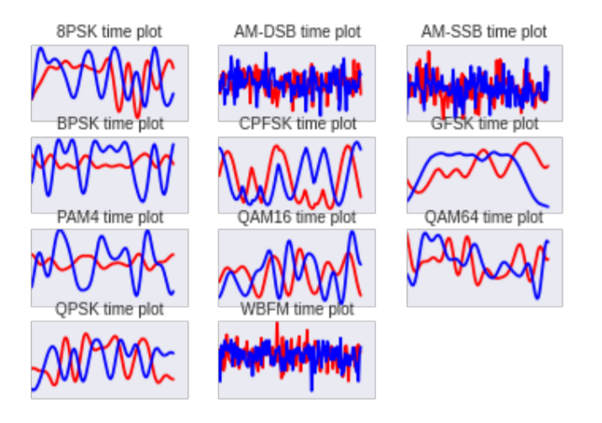
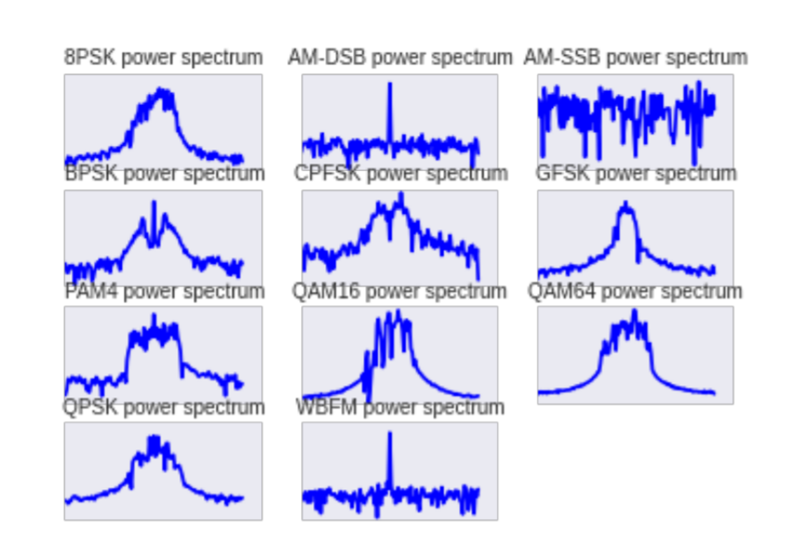
Modulation Recognition: Introduction
Notes:
Here we would introduce modulation recognition like in the report We would first talk about why we use it:
1) Cognitive Radio
2) Signal Space is noisy environment – military and civilian applications
Refer to report

Slide 5
Modulation Recognition: Introduction
Received signal can be written as:
y(t)=f(s(t))+n(t)
11 Different Modulation Schemes :
BPSK, QPSK, 8PSK, 16QAM, 64QAM, BFSK, CPFSK, PAM4, WB-FM, AM-SSB, and AM-DSB.
Existing Methods:
Decision Theory Based Method
Statistical Pattern Recognition Based Method
Notes:
Here we would introduce modulation recognition like in the report We would first talk about why we use it:
1) Cognitive Radio
2) Signal Space is noisy environment – military and civilian applications
Refer to report

Slide 6
Modulation Recognition: Current Limitations
We require prior information of received signals. For large amount of modulation types :
Time consuming
Inefficient
Lack of flexibility
Feature design difficulties for non cooperative environment
Likelihood systems not ideal for unknown channel conditions
Heavy computational load
Notes:
These are combined limitations of both decision theory based and likelihood based methods

Slide 7
Motivation to use Deep Learning
Can be seen as a pattern recognition problem, recognition model can be learned with multiple unknown parameters based on sufficiently large training data.
Success in video, speech, image recognition problems
Improved research accessibility
Better demonstrated performance than feature based systems
To add robustness, flexibility and accuracy
Notes:
•As an alternative, since modulation recognition can be formulated as a pattern recognition problem, statistical pattern recognition approaches are able to learn a recognition model with multiple unknown parameters based on sufficiently large training data.
•Pattern recognition methods normally focus on feature extraction and classification algorithms.
• The existing feature extraction methods use instantaneous amplitude, frequency and phase , high-order statistics (HOS), cyclostationary characteristics, while the existing classifiers include decision tree, support vector machine (SVM) and artificial neural network.
•To add to robustness and accuracy for the modulation classifier Deep Learning can be the perfect solution for the problem
Refer to report

Slide 8
Problem Statement
" N class decision problem where we input a complex time series signal (with in- phase and quadrature components) and train a network on windowed sequences of the time series signal. "
Notes:
In terms of deep earning, the problem of modulation recognition can be boiled down to the following problem statement:

Slide 9
Objective
" To add robustness and accuracy to modulation classification at the receiving end of transmission using deep learning techniques to accomplish that and finally compare different techniques used "

Slide 10
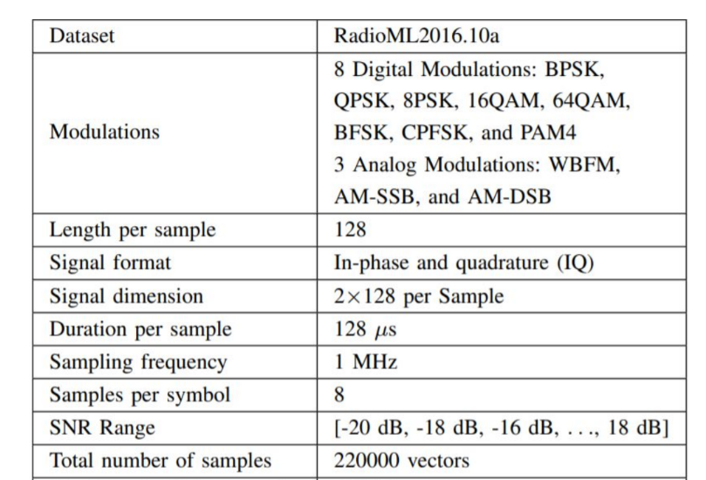
Dataset
Notes:
3 slides: how original dataset looked like – We sample in-phase and quadrature components of a radio signal at discrete time steps through an analog to digital converted with a carrier frequency roughly centered on the carrier of interest to obtain a 2xN complex valued vector

Slide 11
Networks Deployed
Convolutional Neural Network
Long Short Term Memory
ResNet
InceptionNet
CNN- LSTM
Dual Stream CNN/ CNN-LSTM
Attention Modules
VGG
Notes:
Mention paper and crucial ideas. And give references or list of papers: with main idea in one sentence. Like bullets

Slide 12
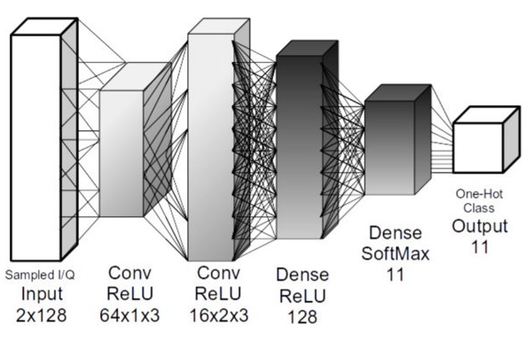
Convolutional Neural Network : General Architecture
[O’Shea, Timothy J., Johnathan Corgan, and T. Charles Clancy. "Convolutional radio modulation recognition networks." International conference on engineering applications of neural networks. Springer, Cham, 2016.]
Notes:
Mention paper and crucial ideas. And give references or list of papers: with main idea in one sentence. Like bullets

Slide 13
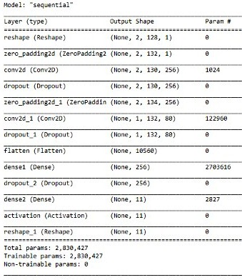
Convolutional Neural Network : ImplementedSequential Model
Notes:
Mention paper and crucial ideas. And give references or list of papers: with main idea in one sentence. Like bullets

Slide 14
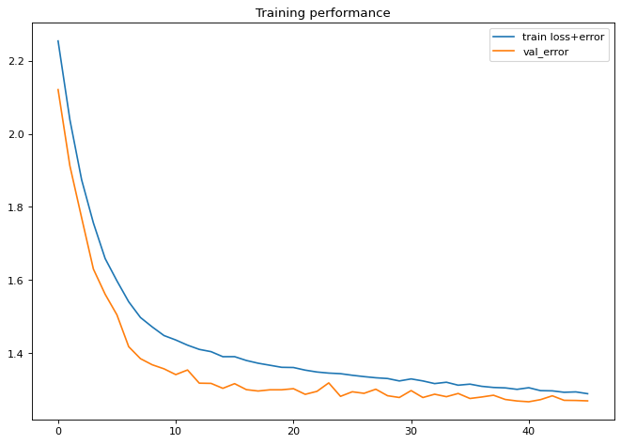
Convolutional Neural Network : Training Performance
Notes:
Mention paper and crucial ideas. And give references or list of papers: with main idea in one sentence. Like bullets

Slide 15
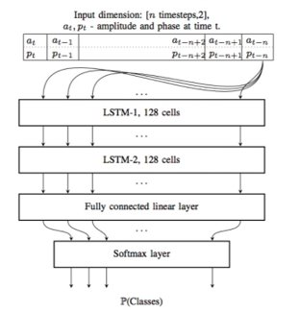
Long Short Term Memory: General Architecture
[Ramjee, Sharan, et al. "Fast deep learning for automatic modulation classification." arXiv preprint arXiv:1901.05850 (2019).]
Notes:
Mention paper and crucial ideas. And give references or list of papers: with main idea in one sentence. Like bullets

Slide 16
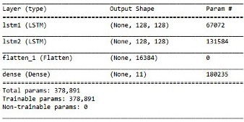
Long Short Term Memory: Implemented Sequential Model
Notes:
Mention paper and crucial ideas. And give references or list of papers: with main idea in one sentence. Like bullets

Slide 17
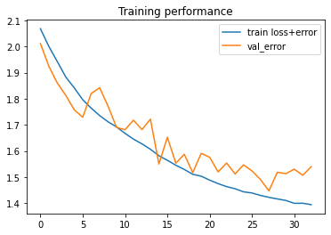
Long Short Term Memory: Training Performance
Notes:
Mention paper and crucial ideas. And give references or list of papers: with main idea in one sentence. Like bullets

Slide 18
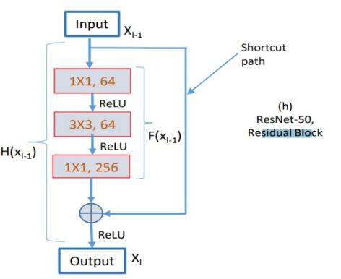
ResNet: General Architecture
[Kumar, Yogesh, et al. "Automatic modulation classification based on constellation density using deep learning." IEEE Communications Letters 24.6 (2020): 1275-1278.]
Notes:
Mention paper and crucial ideas. And give references or list of papers: with main idea in one sentence. Like bullets

Slide 19
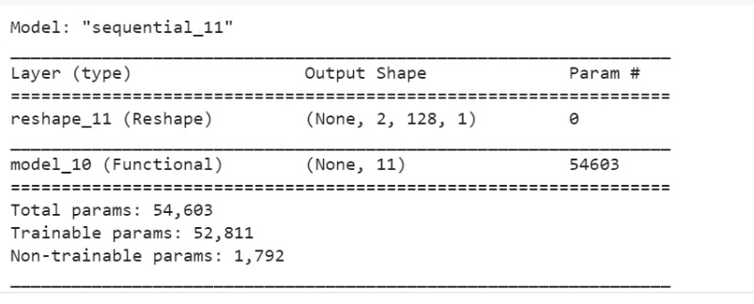
ResNet: Implemented Model
Notes:
Mention paper and crucial ideas. And give references or list of papers: with main idea in one sentence. Like bullets

Slide 20
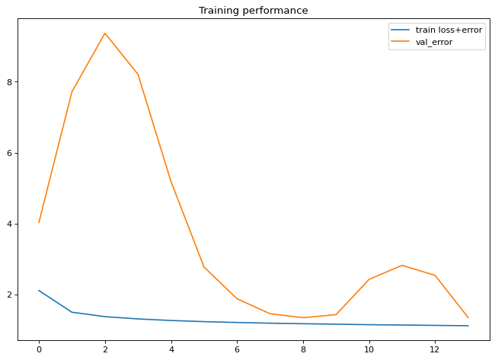
ResNet: Training Performance
Notes:
Mention paper and crucial ideas. And give references or list of papers: with main idea in one sentence. Like bullets

Slide 21
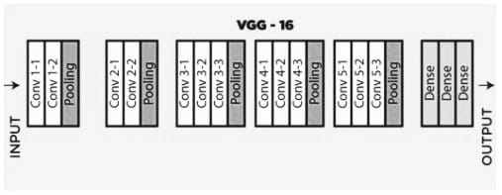
VGG: General Architecture
[“VGG-16: CNN Model.” GeeksforGeeks, 27 Feb. 2020, www.geeksforgeeks.org/vgg-16-cnn-model/. ]
Notes:
Mention paper and crucial ideas. And give references or list of papers: with main idea in one sentence. Like bullets

Slide 22
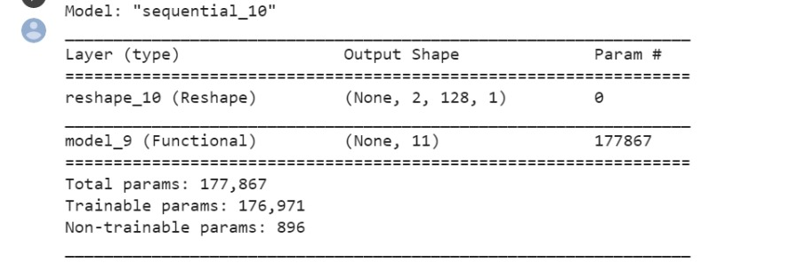
VGG: Implemented Sequential Model
Notes:
Mention paper and crucial ideas. And give references or list of papers: with main idea in one sentence. Like bullets

Slide 23
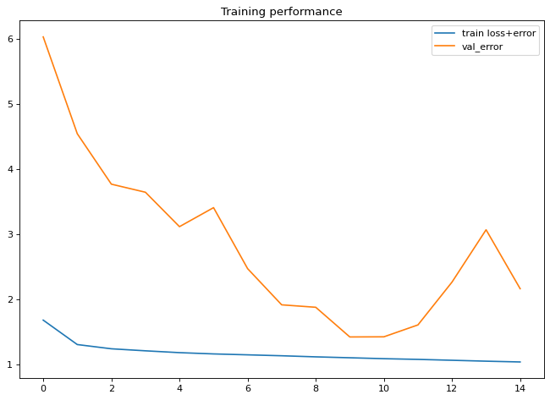
VGG: Training Performance
Notes:
Mention paper and crucial ideas. And give references or list of papers: with main idea in one sentence. Like bullets

Slide 24
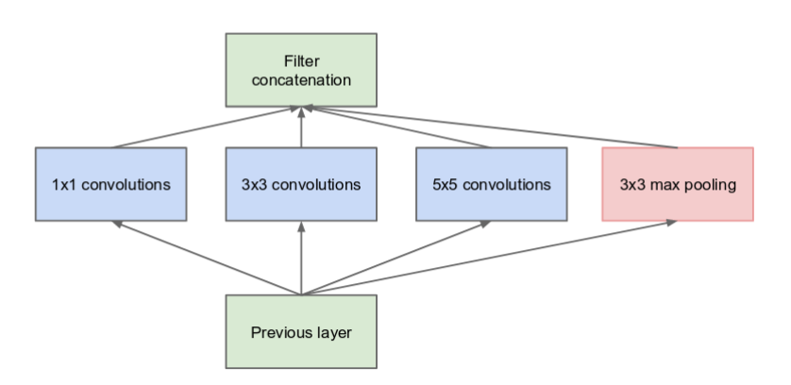
InceptionNet: General Architecture
[Christian Szegedy, Wei Liu, Yangqing Jia, Pierre Sermanet, Scott E. Reed, Dragomir Anguelov, Dumitru Erhan, Vincent Vanhoucke, and Andrew Rabinovich. Going deeper with convolutions. CoRR, abs/1409.4842, 2014.]
Notes:
Mention paper and crucial ideas. And give references or list of papers: with main idea in one sentence. Like bullets

Slide 25
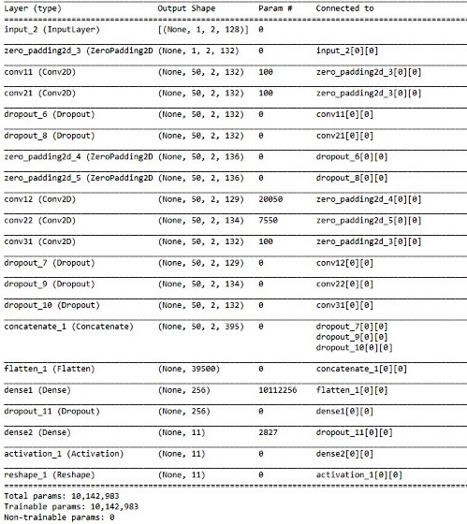
InceptionNet: Implemented Model
Notes:
Mention paper and crucial ideas. And give references or list of papers: with main idea in one sentence. Like bullets

Slide 26
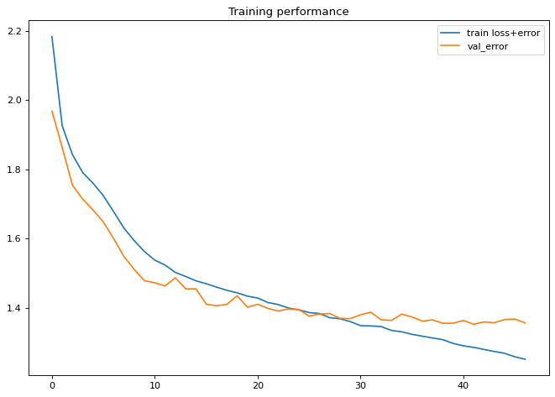
InceptionNet: Training Performance
Notes:
Mention paper and crucial ideas. And give references or list of papers: with main idea in one sentence. Like bullets

Slide 27
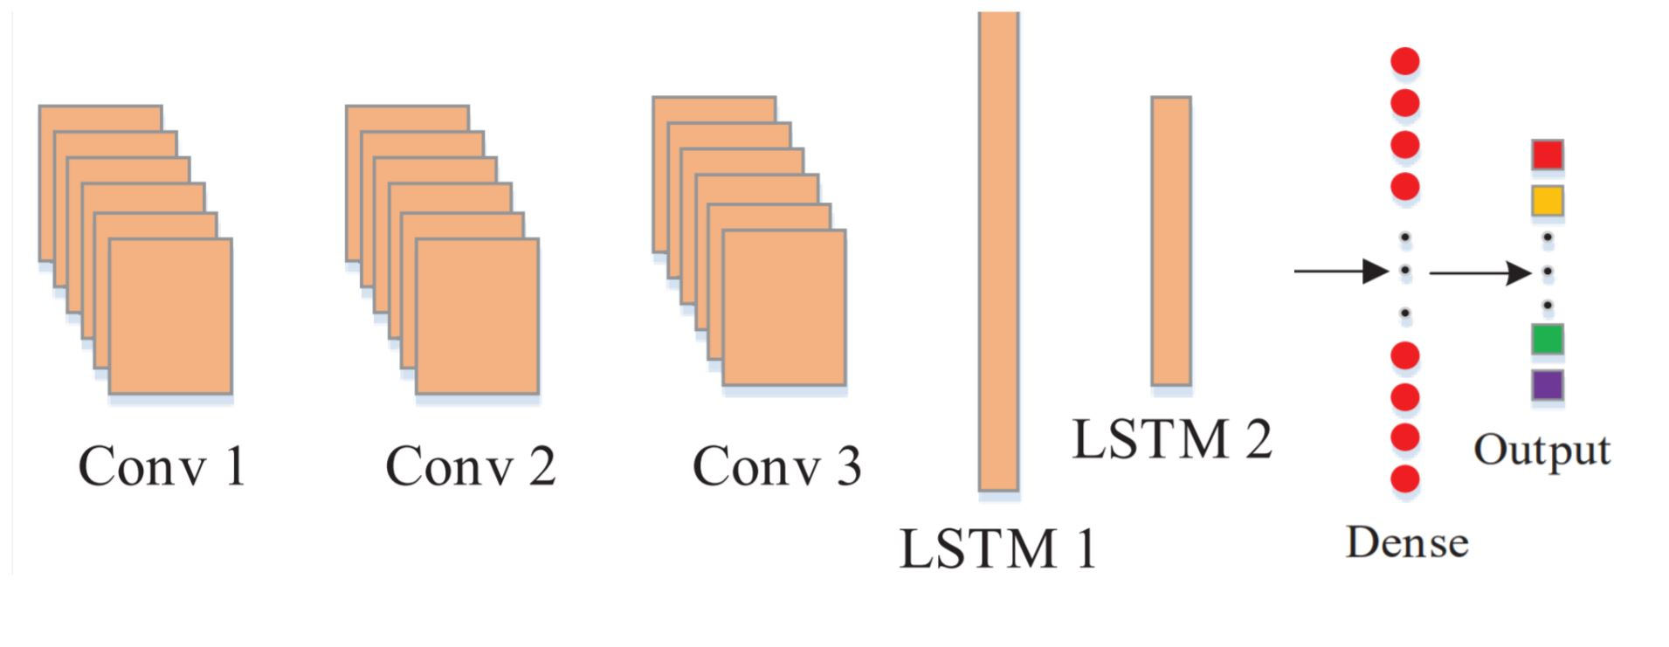
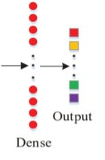
CNN-LSTM: General Architecture
Zhang, Zufan, et al. "Automatic Modulation Classification Using CNN-LSTM Based Dual-Stream Structure." IEEE Transactions on Vehicular Technology 69.11 (2020): 13521-13531.
Notes:
Mention paper and crucial ideas. And give references or list of papers: with main idea in one sentence. Like bullets

Slide 28
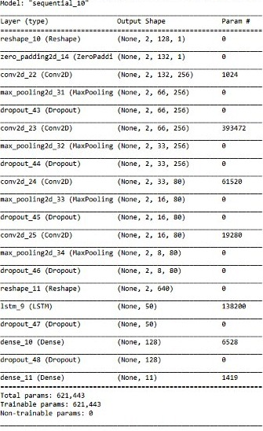
CNN-LSTM: Implemented Sequential Model
Notes:
Mention paper and crucial ideas. And give references or list of papers: with main idea in one sentence. Like bullets

Slide 29
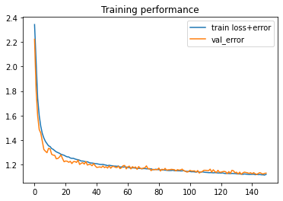
CNN-LSTM: Training Performance
Notes:
Mention paper and crucial ideas. And give references or list of papers: with main idea in one sentence. Like bullets

Slide 30
CNN-LSTM (Attention): General Architecture
Attention
Zhang, Zufan, et al. "Automatic Modulation Classification Using CNN-LSTM Based Dual-Stream Structure." IEEE Transactions on Vehicular Technology 69.11 (2020): 13521-13531.
Notes:
Mention paper and crucial ideas. And give references or list of papers: with main idea in one sentence. Like bullets

Slide 31
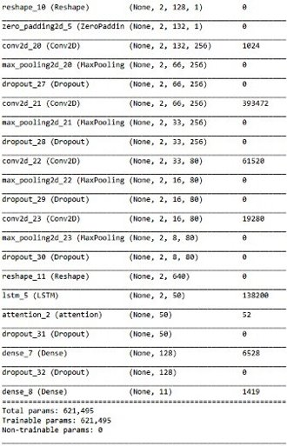
CNN-LSTM (Attention): Implemented Model
Notes:
Mention paper and crucial ideas. And give references or list of papers: with main idea in one sentence. Like bullets

Slide 32
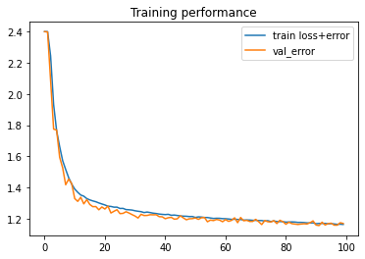
CNN-LSTM (Attention): Training Performance
Notes:
Mention paper and crucial ideas. And give references or list of papers: with main idea in one sentence. Like bullets

Slide 33
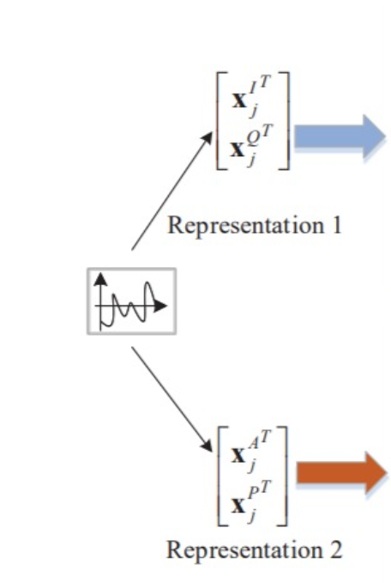
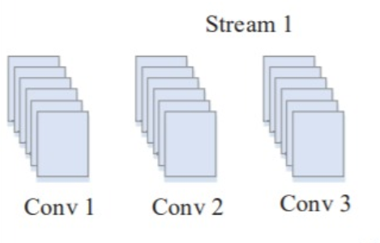
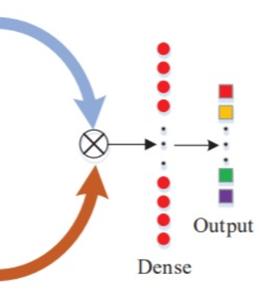
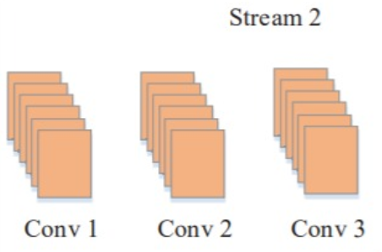
Dual Stream CNN: General Architecture
Zhang, Zufan, et al. "Automatic Modulation Classification Using CNN-LSTM Based Dual-Stream Structure." IEEE Transactions on Vehicular Technology 69.11 (2020): 13521-13531.
Notes:
Mention paper and crucial ideas. And give references or list of papers: with main idea in one sentence. Like bullets

Slide 34
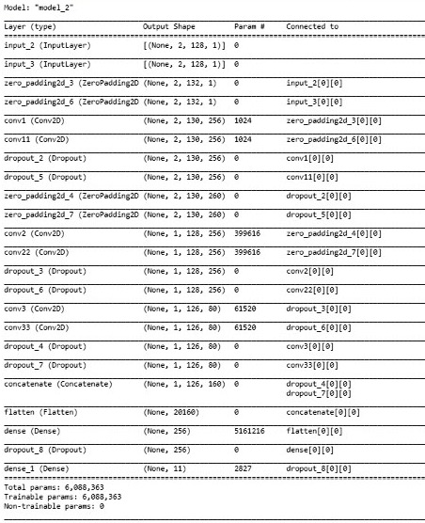
Dual Stream CNN: Implemented Model
Notes:
Mention paper and crucial ideas. And give references or list of papers: with main idea in one sentence. Like bullets

Slide 35
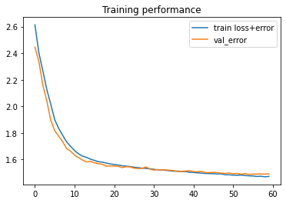
Dual Stream CNN: Training Performance
Notes:
Mention paper and crucial ideas. And give references or list of papers: with main idea in one sentence. Like bullets

Slide 36
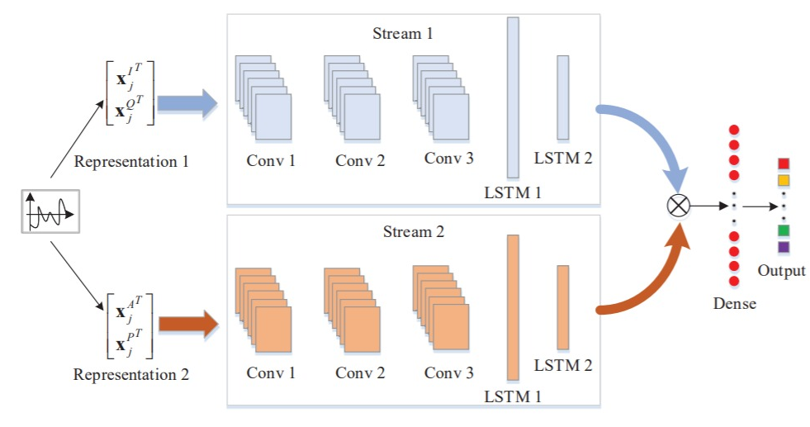
Dual Stream CNN-LSTM: General Architecture
Zhang, Zufan, et al. "Automatic Modulation Classification Using CNN-LSTM Based Dual-Stream Structure." IEEE Transactions on Vehicular Technology 69.11 (2020): 13521-13531.
Notes:
Mention paper and crucial ideas. And give references or list of papers: with main idea in one sentence. Like bullets

Slide 37
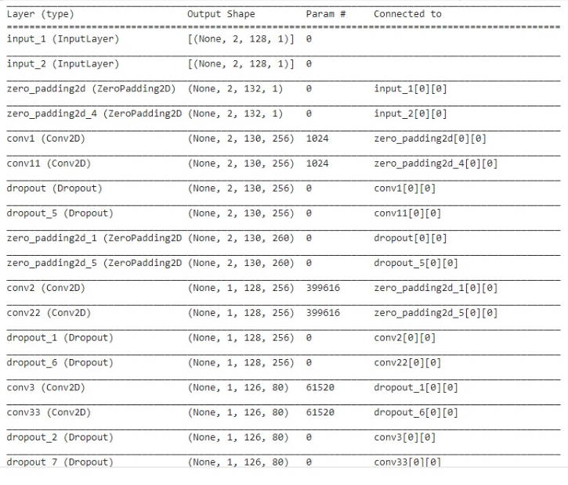
Dual Stream CNN-LSTM: Implemented Model (1)
Notes:
Mention paper and crucial ideas. And give references or list of papers: with main idea in one sentence. Like bullets

Slide 38
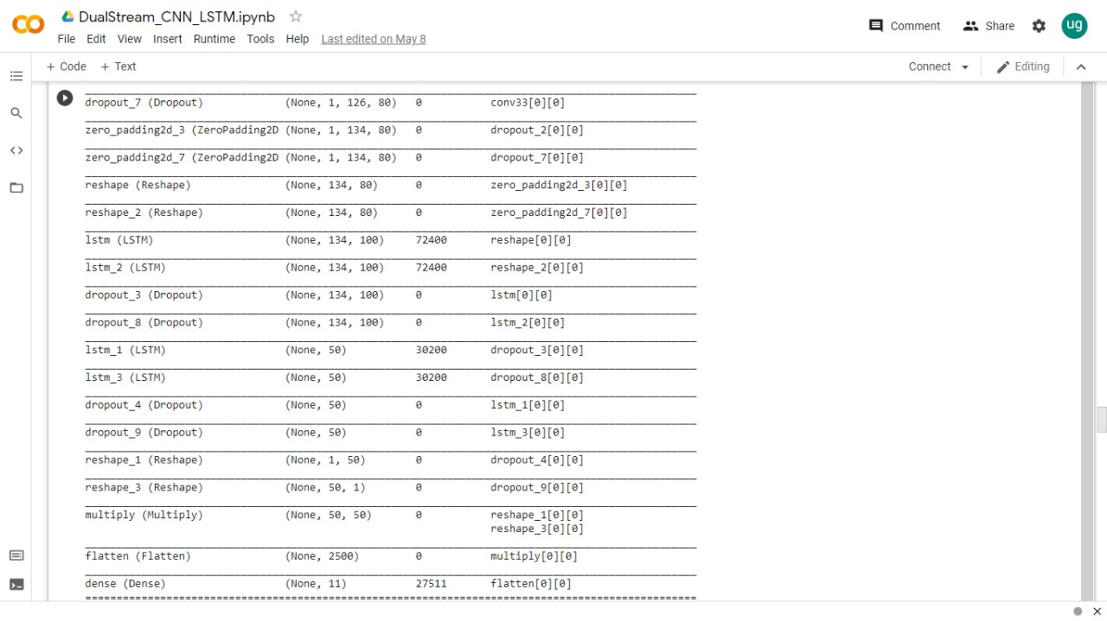
Dual Stream CNN-LSTM: Implemented Model(2)
Notes:
Mention paper and crucial ideas. And give references or list of papers: with main idea in one sentence. Like bullets

Slide 39
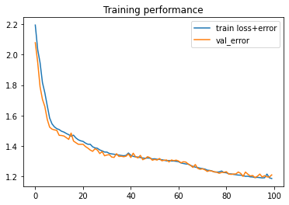
Dual Stream CNN-LSTM: Training Performance
Notes:
Mention paper and crucial ideas. And give references or list of papers: with main idea in one sentence. Like bullets

Slide 40
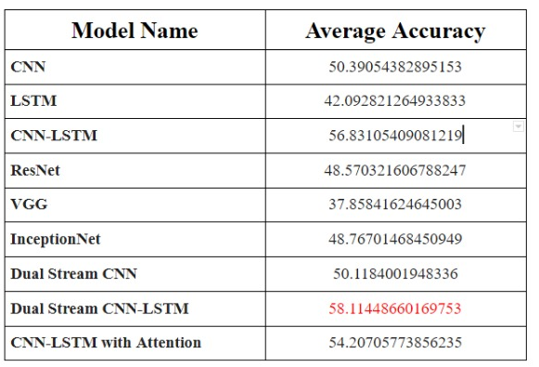
Results: Average Accuracy
Notes:
Mention paper and crucial ideas. And give references or list of papers: with main idea in one sentence. Like bullets

Slide 41
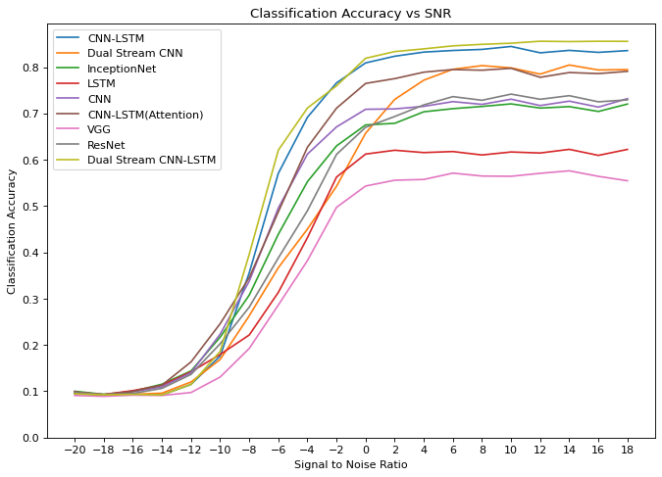
Results: SNR vs Accuracy
Notes:
Mention paper and crucial ideas. And give references or list of papers: with main idea in one sentence. Like bullets

Slide 42
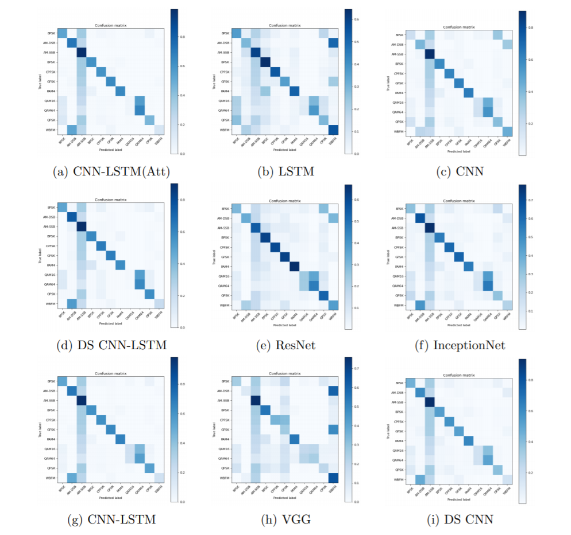
Results: Confusion Matrices
Notes:
Mention paper and crucial ideas. And give references or list of papers: with main idea in one sentence. Like bullets

Slide 43
Conclusion
Breadth first implementation of 9 architectures, in order to find model most suitable for development.
Classification accuracy of our models is lower than published models with similar architectures.
Validation accuracy is not a simple function of the depth of the Neural Network but of the features learned by these layers.
Dual Stream CNN-LSTM has the best validation accuracy
CNN-LSTM based architectures perform much better than other architectures.
Due to temporal & spatial variations of radio signals.
Notes:
Mention paper and crucial ideas. And give references or list of papers: with main idea in one sentence. Like bullets

Slide 44
Conclusion
Confusion matrices show :
that AM – SSB is mostly misclassified
QAM16 is often not classified.
Sharp Drop off in Accuracy from 0 SNR begins.
Highlights need for denoising
Dual Stream architectures allow us to train network on both In-phase & Quadrature Data as well as Amplitude & Phase Data
Combining Dual Stream architecture with CNN-LSTM networks gives network more information
Cleaner diagonals for CNN-LSTM based networks
Notes:
Mention paper and crucial ideas. And give references or list of papers: with main idea in one sentence. Like bullets

Slide 45
Future Work
Exhaustive exploration of hyperparameters
Run on larger datasets made available by DeepSig.
More modulation types
More data per modulation type
Need for denoising and signal correction
Use of Correctional Neural Networks
Phase offset
Frequency Offset
Denoising Auto-Encoders
IQ data
Separate IQ & AP Auto- Encoders for Dual stream networks
Stacked Autoencoders
Notes:
Mention paper and crucial ideas. And give references or list of papers: with main idea in one sentence. Like bullets

Slide 46
Future Work
Explore use of only Amplitude Phase data
Explore BiLSTM, and Deep Complex Networks
Further exploration of Attention modules
Need for networks that can resample, synchronize, and remove non-linear channel distortions for real world use
Explore implementation on edge and/or with Software Defined Radio (GNURadio)
Notes:
Mention paper and crucial ideas. And give references or list of papers: with main idea in one sentence. Like bullets

